Slide 1

A Project Report
On
MOBILE ROBOT STRUCTURE, DESIGN AND SIMULATION FOR SURVEILLANCE OF OUTDOOR SECURITY
Submitted by
Shreya Ojha (2016614)
Aditi Sharma (2016514)
Varnika Chaturvedi (2016627)
Supervised by
Dr S. K. Das
SCHOOL OF AUTOMATION
BANASTHALI VIDYAPITH RAJASTHAN
April 2023

Slide 2

Presentation Outlines
Introduction
Problem Description
Solution Methodology
Results & Discussions
Conclusion

Slide 3
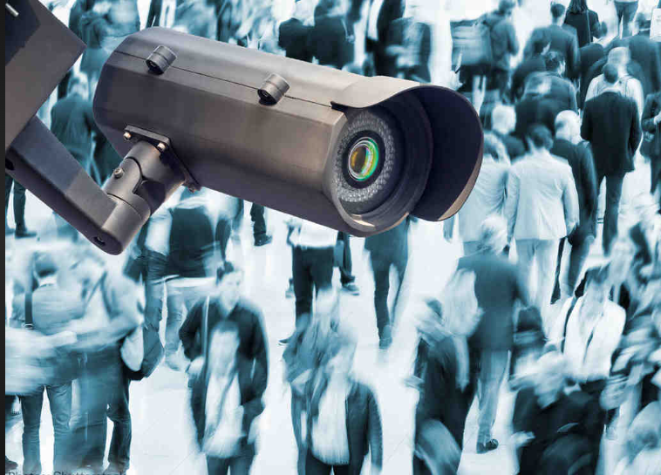
Introduction
Surveillance is the process of systematic observation or direction maintained over an individual, group, etc.
The act of surveillance can be performed each indoor or outside areas by humans or with the help of embedded systems like robots
A robot is a machine, especially one programmable by a computer that can carry out a complex series of actions automatically.
The mechanism consists of DC motors, wheel chassis, battery, ESP 32 cam module and motor driver.
We will use wireless transmission camera that gives video information which will be received at the user end.

Slide 4
Problem Description
In various areas there is a need of constant surveillance. The current surveillance system includes monitoring by using CCTV cameras and other monitoring system. Mostly these systems are stationary and they can cover a limited area.
These systems cannot be used to cover a large area as well as they cannot be controlled using any mobile device.
This project is aimed at developing a surveillance system which can be controlled remotely by using web app. It includes a robot with a wireless camera attach to it.
This robot captures video and transmits it to the connected web app which is used to control the robot.

Slide 5
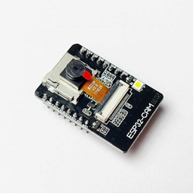
Solution Methodology :
Components
ESP 32 camera
ESP32-CAM is a low-cost ESP32-based development board with onboard camera
The ESP32-CAM suit for IOT applications such as:
Smart home devices image upload
Wireless monitoring
facial recognition
In our project, The ESP32-CAM hosts a web server that shows video streaming and buttons to control the servo motors to move the camera. access to two GPIOs to control two servo motors.

Slide 6
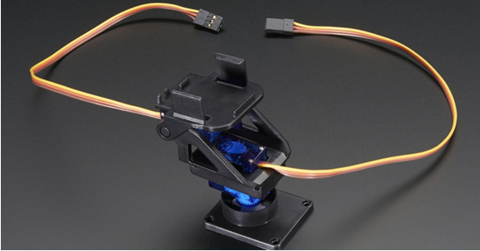
Pan Tilt Servo Assembly
The Servo Tilt / Pan Kit for SG-90 Servos is a DIY Pan-Tilt chassis that can rotate up to 180 degrees vertically and horizontally.
widely used in surveillance applications for high accuracy positioning of sensor payloads such as cameras and laser pointers.
In our project the pan-tilt rotate roughly 180° from side-to-side and can tilt up & downwards around 150°. It is 38mm x 36mm space mount the camera or sensor.

Slide 7
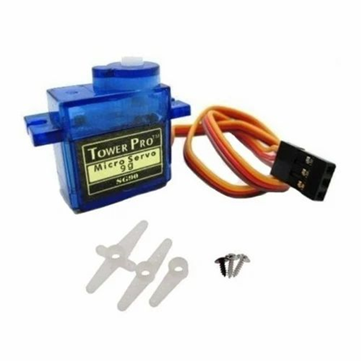
SG 90 Servo MOTOR
SG90 is a popular micro servo motor commonly used in hobbyist and DIY projects. It is a small, low-cost servo motor that can rotate 180 degrees with a maximum torque of 1.8 kg-cm.
Applications:-
Robotics
Telescope
Industrial production
In our project, it is used control its speed.

Slide 8
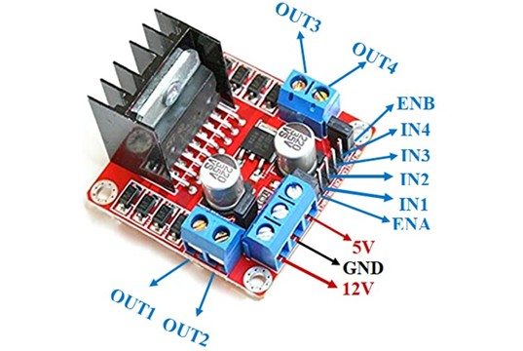
L298N Motor Driver
The L298N is a dual H-Bridge motor driver which allows speed and direction control of two DC motors at the same time. The module can drive DC motors that have voltages between 5 and 35V, with a peak current up to 2A.
Applications:-
Drive DC motors.
Drive stepping motors
In Robotics
In our project, it uses the H-Bridge technique to control the direction of rotation of a DC motor. In this technique, H-Bridge controlled DC motor rotating direction by changing the polarity of its input voltage

Slide 9
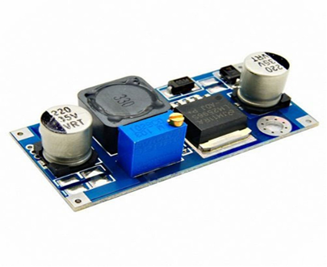
UBEC/buck Converter
A buck converter or step-down converter is a DC-to-DC converter which steps down voltage (while stepping up current) from its input (supply) to its output (load). It is a class of switched-mode power supply.
Applications:
It is used in battery power systems such as battery chargers for mobile phones, laptops, and power banks
It is used in solar chargers
In our project, it performs step-down conversion of the applied dc input signal.

Slide 10

Arduino UNO
The Arduino Uno is an open-source microcontroller board based on the Microchip ATmega328P microcontroller and developed by Arduino.cc and initially released in 2010. It is considered as the powerful board used in various projects. Arduino.cc developed the Arduino UNO board.
Applications:-
Weighing Machines.
Traffic Light Count Down Timer.
Parking Lot Counter.
In our project, it is used to program ESP 32 board.

Slide 11
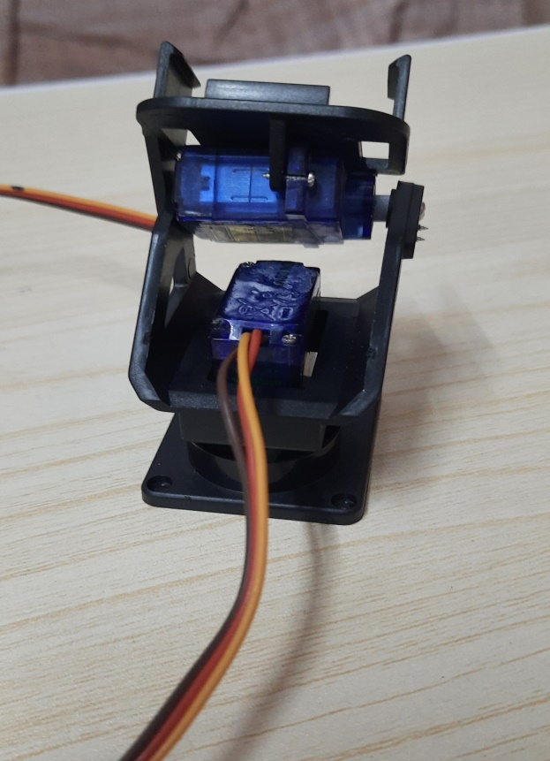
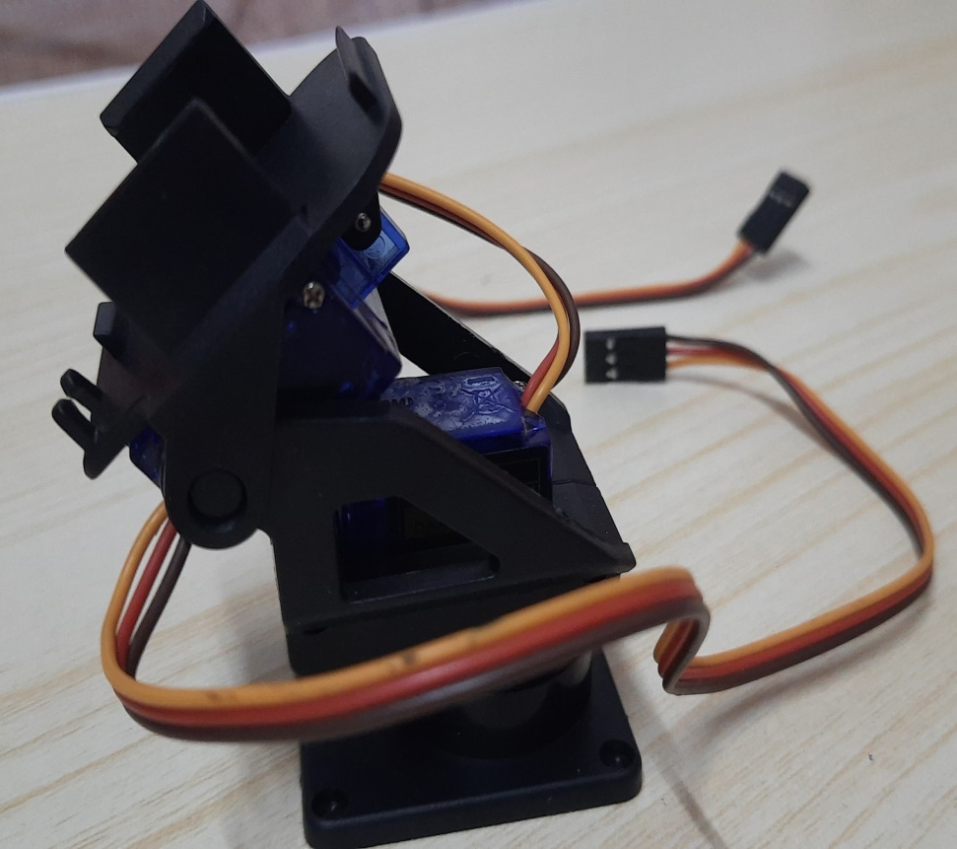
Process and circuit diagram
Step 1: First assemble the pan tilt and fix servos.

Slide 12
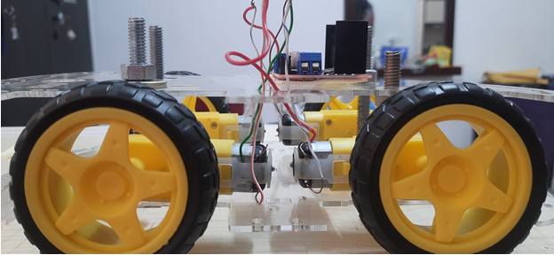
Step 2: For assemble the car, firstly solder the wires to gear motors. Then, mount all four motors on car chassis. Now attach both the car chassis plate using screws and then connect DC motors on each sides.

Slide 13
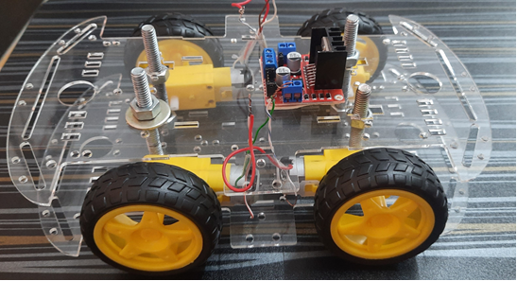
Step 3: Attach L298N motor driver module on car chassis.

Slide 14
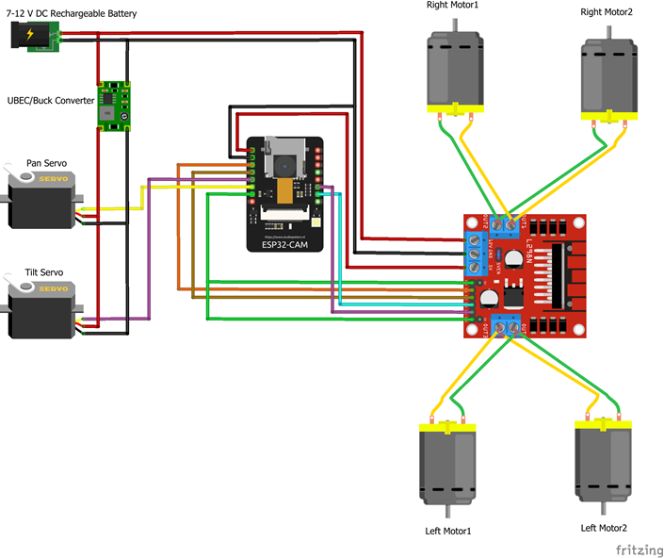
Step 4: Now, make the connections as per circuit diagram:

Slide 15
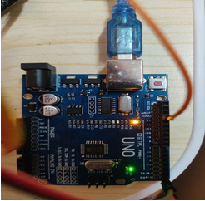
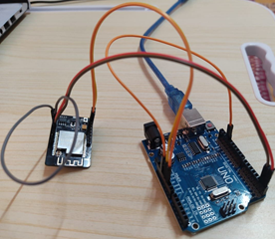
Step 5: Fix esp32 cam module on structure. Now, mount pan tilt assembly on car chassis.
Step 6: Connect pan servo and tilt servo to I014 and I015 respectively.
Step 7: Connect USB to battery supply and provide +5V and ground to servos.
Step 8: Attach DC battery power connectors to motor driver module to +5V pin and ground pin.
Step 9: Attach wheels to car.
Step 10: Now we use Arduino UNO for uploading code.

Slide 16
Step 11: Connect battery to car.
Step 12: Let us open mobile app now. Go to wi-fi settings and connect to my wi-fi car ssid using password. Open google chrome browser on mobile and type 192.168.4.1 . It will open our camera car control app.

Slide 17
Purpose
It serves the following purpose:-
Video Surveillance Robot in Agriculture:-The fields might only need to be placed under video surveillance when the crops are reaching maturity. Surveillance of pastures is advantageous only while cattle are roaming around them.
To Catch a Thief:-Artificial intelligence, streaming video, and other connected technologies are giving us security guards that can work 24 hours a day, can see in the dark, and have eyes—literally—in the backs of their heads.
Robotics in Security and Military:-Mobile robotics plays an increasingly important role in military matters, from patrol to dealing with potential explosives.
Virtual security robots:-Virtual robots are essentially AI algorithms that can identify and protect your data and devices against malware.
Search and rescue robots:-In disaster zones that are hard to reach and a danger to life, robots provide invaluable support to human search and rescue teams.

Slide 18
Results & Discussions
We have successfully implemented the working of the wireless video surveillance robot controlled using android mobile device.
The completed project is a small land-based robot that can be controlled from a web app using a Wi-Fi Direct connection.
The app allows the user to send commands to the robot for moving forward and backwards, turning left and right, and stopping. Even the real time video feel is successfully achieved using the Wi-Fi technology on our designed webs application.
It could be a great solution to various problems or situation where wireless Surveillance is needed our project has tremendous scope as it uses the latest technology in the market.

Slide 19
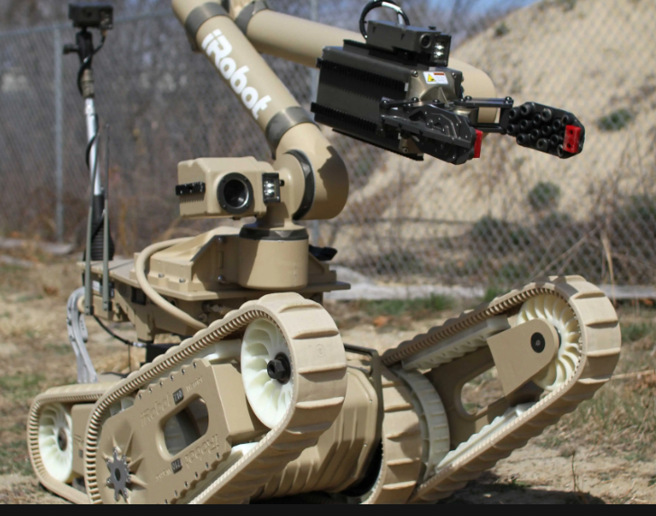
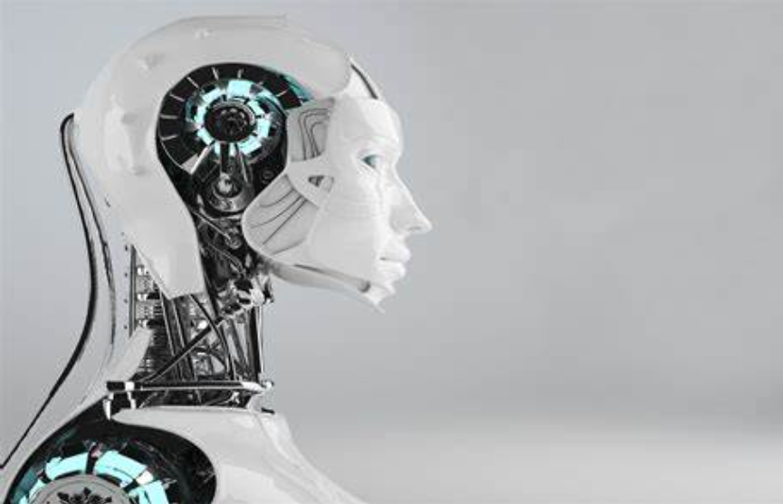
Conclusion
Here we conclude that the surveillance robot can be used for security purpose in industries, homes, in agriculture lands to monitor the fields and security purpose, in military to monitor the border areas, to surveillance the disaster affected areas where a person cannot reach. Here we can stream live video using a website by connecting it to an external web server. Further this robot can be altered with a specific set of sensors depending upon the terrain and function to be carried.

Slide 20
References
Introduction to Autonomous Mobile Robots by Ronald C. Arkin, Roland Siegwart, Illah R. Nourbakhsh, and Davide Scaramuzza
International Journal of Engineering Research & Technology (IJERT) ISSN: 2278-0181 Published by, www.ijert.org ,ICONNECT - 2k18 Conference Proceedings
European Journal of Molecular & Clinical Medicine ISSN 2515-8260 Volume 7, Issue 4, 2020 2586, DESIGN OF MOBILE SURVEILLANCE AND SECURITY BOT FOR HOME SAFETY
Middle-East Journal of Scientific Research 24 (S1): 155-166, 2016, ISSN 1990-9233, DOI: 10.5829/idosi.mejsr.2016.24.S1.33, A Surveillance Robot For Real Time Monitoring And Capturing Controlled Using Android Mobile K. Damodhar, B. Vanathi and K. Shanmugam

